Slide 1
Water Well Condition Prediction in Tanzania
ML for infrastructure Monitoring
Predict well status
Support NGO’S & Government decisions
This project focuses on predicting the condition of water wells in Tanzania using machine learning. The goal is to help organizations identify wells that are non-functional or at risk, so they can prioritize repairs and improve access to clean water.

Slide 2
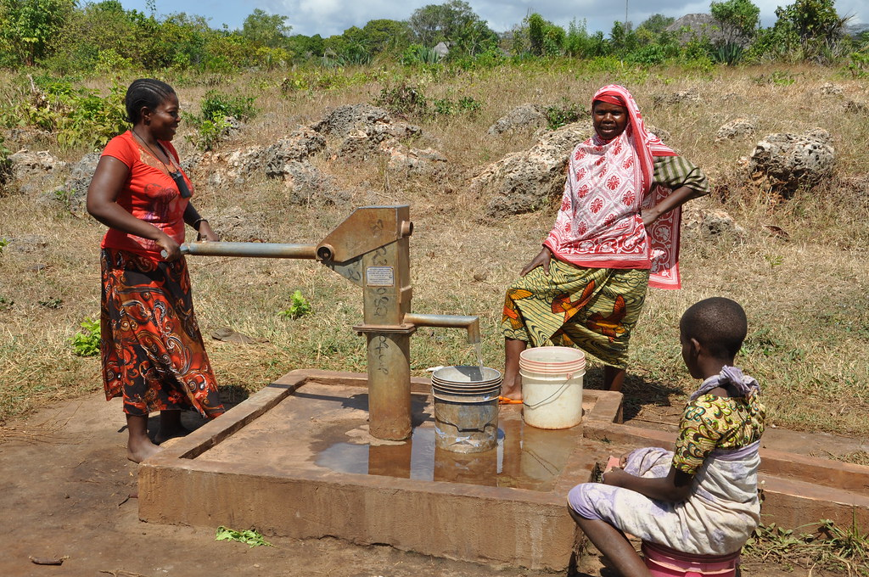
Business Understanding
Tanzania faces challenges in maintaining water infrastructure. Many wells fail over time, and resources are limited. This project aims to help decision-makers identify which wells need attention most urgently:
Limited access to clean water
Many wells are non functional or deteriorating
Need for efficient resource allocation

Slide 3
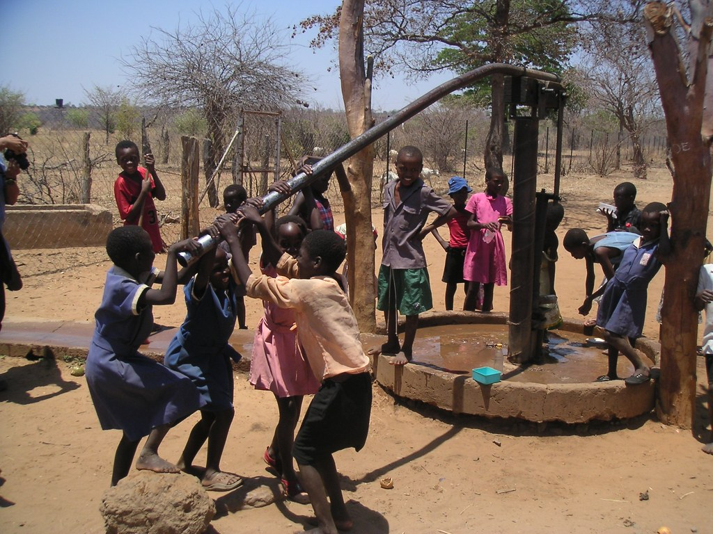
Data Understanding
The dataset contains detailed information about wells, including location, construction, and operational factors. The target variable classifies wells into three categories based on functionality.
59,400 water wells
Features: location, pump&water charactetristics ,construction details etc
Predictive variable: Functional, needs repair or non functional pumps.

Slide 4
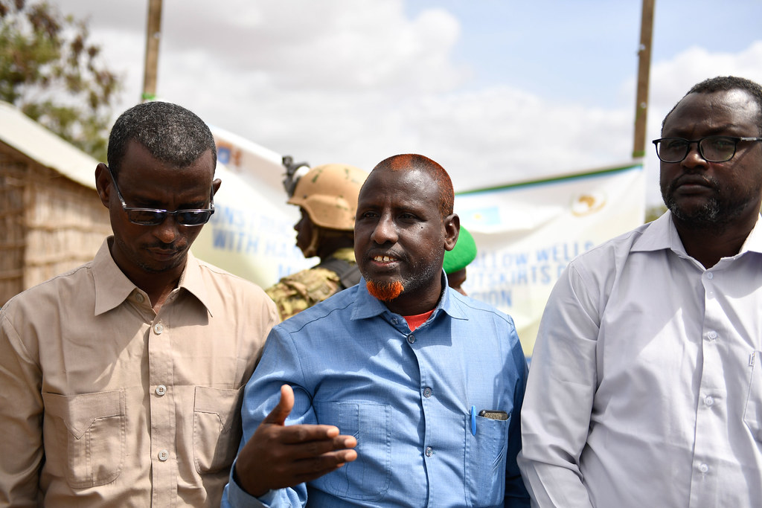
Algorithm Modelling
I built a full machine learning pipeline to ensure consistent preprocessing. Multiple models were tested to identify the best-performing approach.
Data preprocessing pipeline: missing value imputation, feature engineering, encoding categorical variables
Models used: Random Forest, Extra Trees & Gradient Boosting

Slide 5

Model Evaluation
The Random Forest model performed best, achieving about 80% accuracy. However, the model struggles more with identifying wells that need repair, likely due to fewer examples in the dataset.
Random Forest is the best model
Accuracy: 80.4%
Strong performance: functional wells & non functional wells
Challenge: lower accuracy for “needs repair”

Slide 6
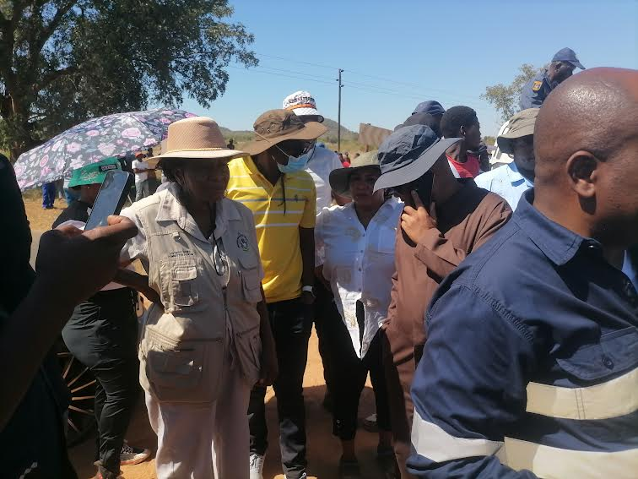
Key Insights
The model revealed that geography plays a major role in well performance. Additionally, older wells and those with low water quantity are more likely to fail.
Location is the strongest predictor
Older wells fail more often
Water quantity strongly affects functionality
High population increases strain

Slide 7
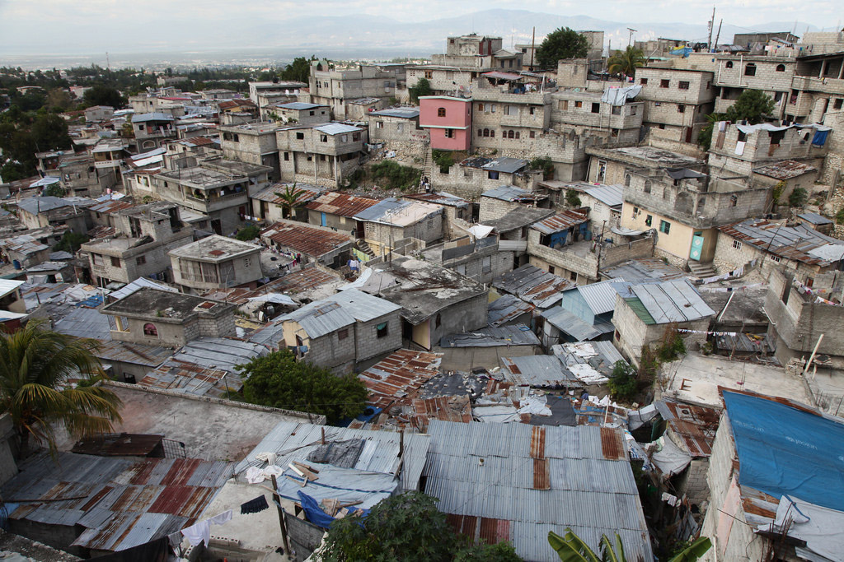
Recommendations
Based on the model, resources should be focused on regions with higher failure rates. Preventative maintenance on older wells can also reduce long-term costs.
Prioritise high risk regions
Repair aging infrastructure
Monitor wells with low water levels
Focus on high demand areas

Slide 8
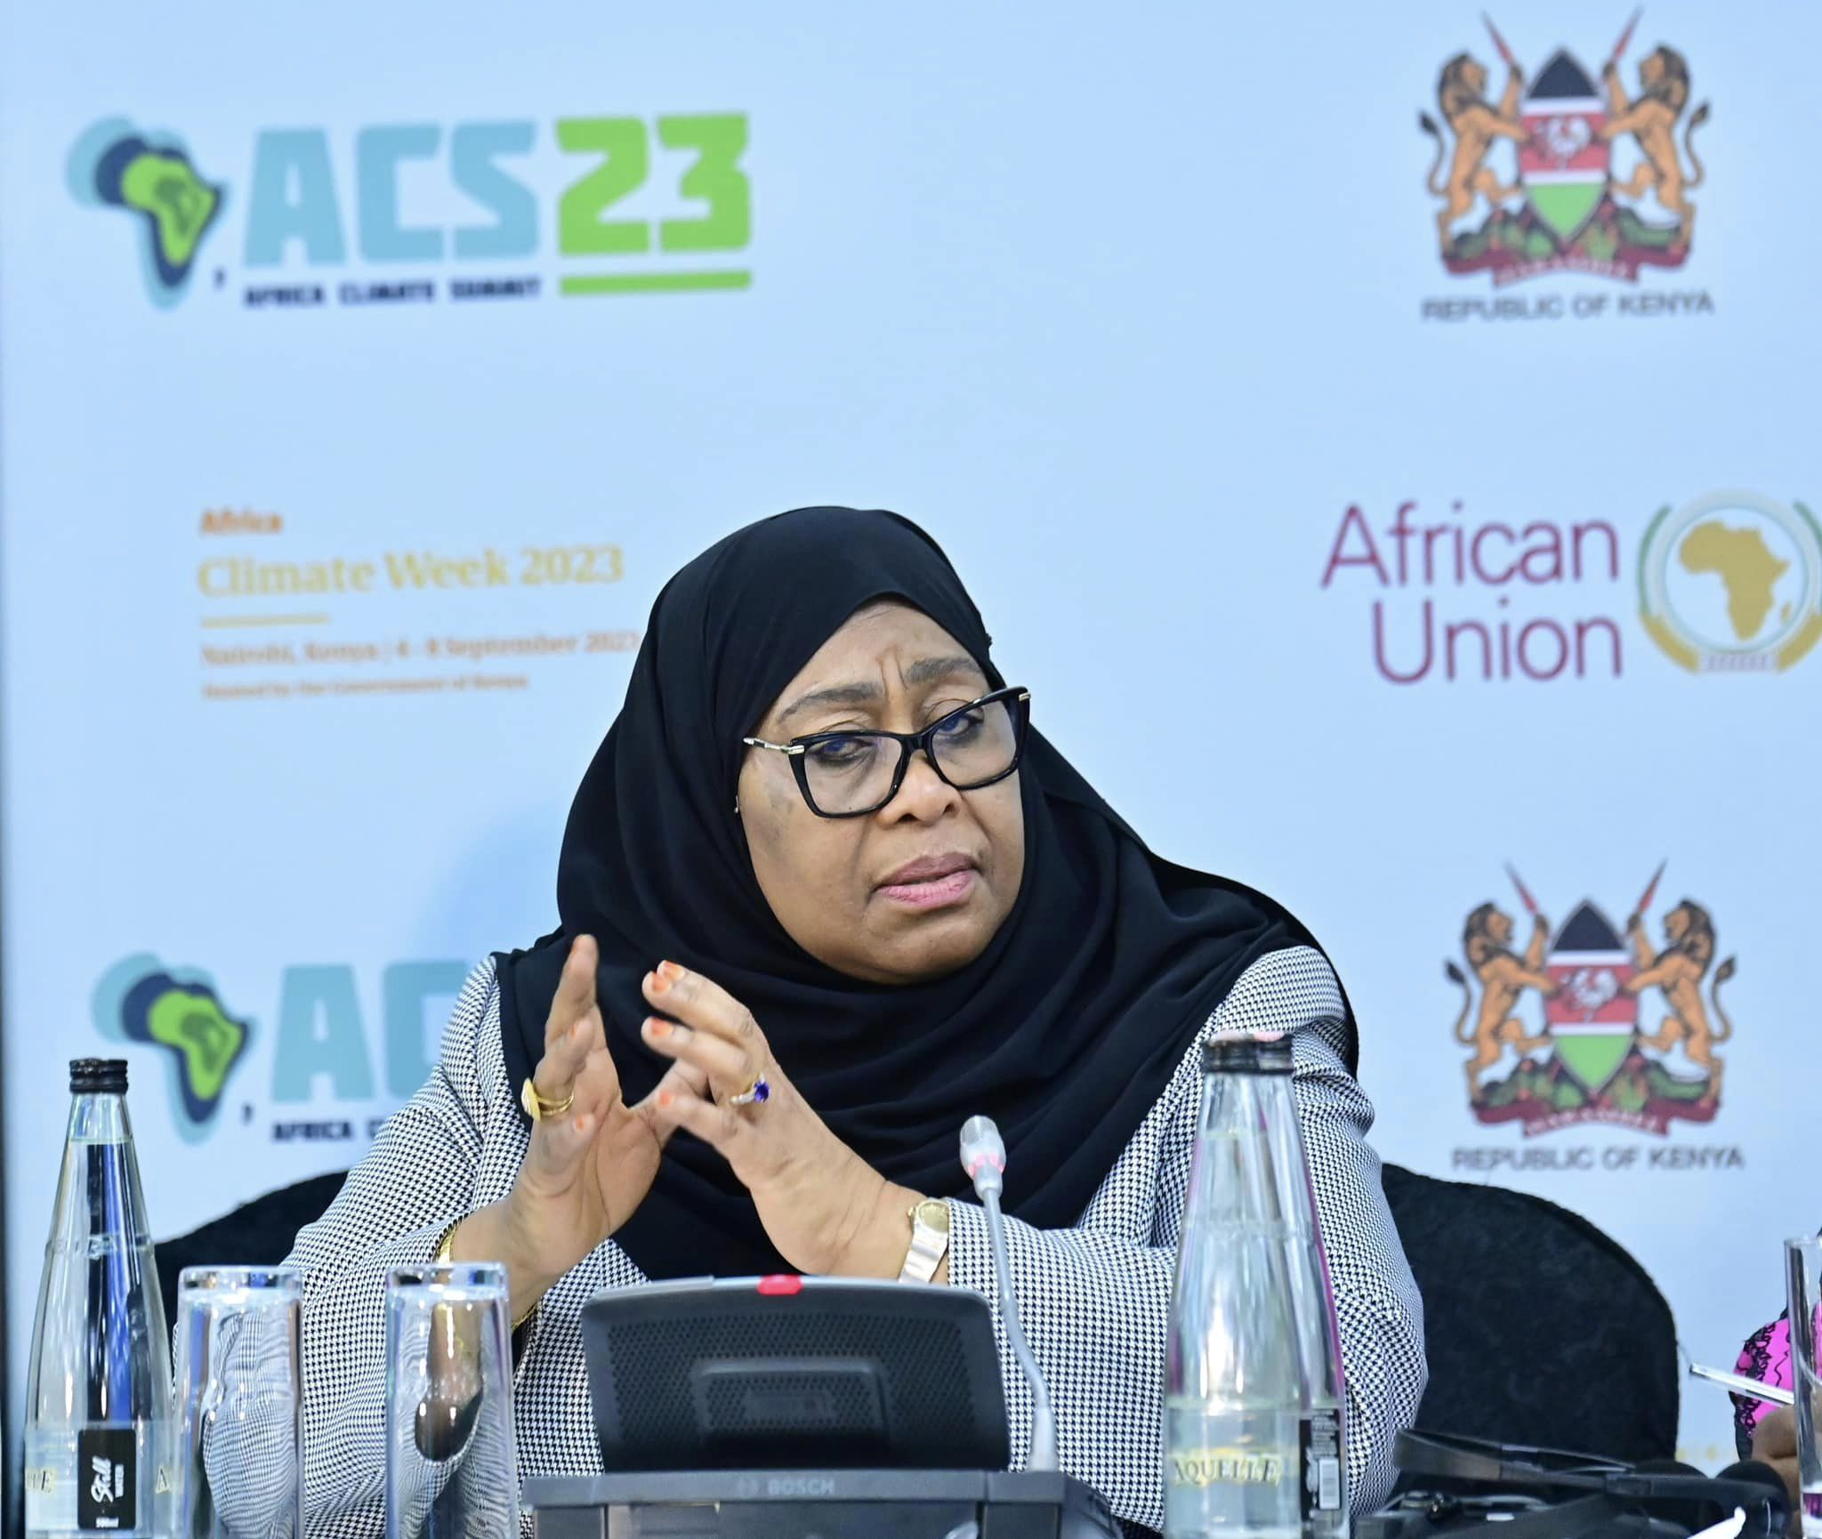
Project’s Next Steps
Future improvements could focus on better identifying wells that are close to failure. This model could also be deployed as a real-time decision-support system.
Improve detection of ‘needs repair’ wells
Perform geospatial analysis
Tune models further
Deploy as a decision tool
Thankyou.
Project by: Mercy Apondi

